Slide 1
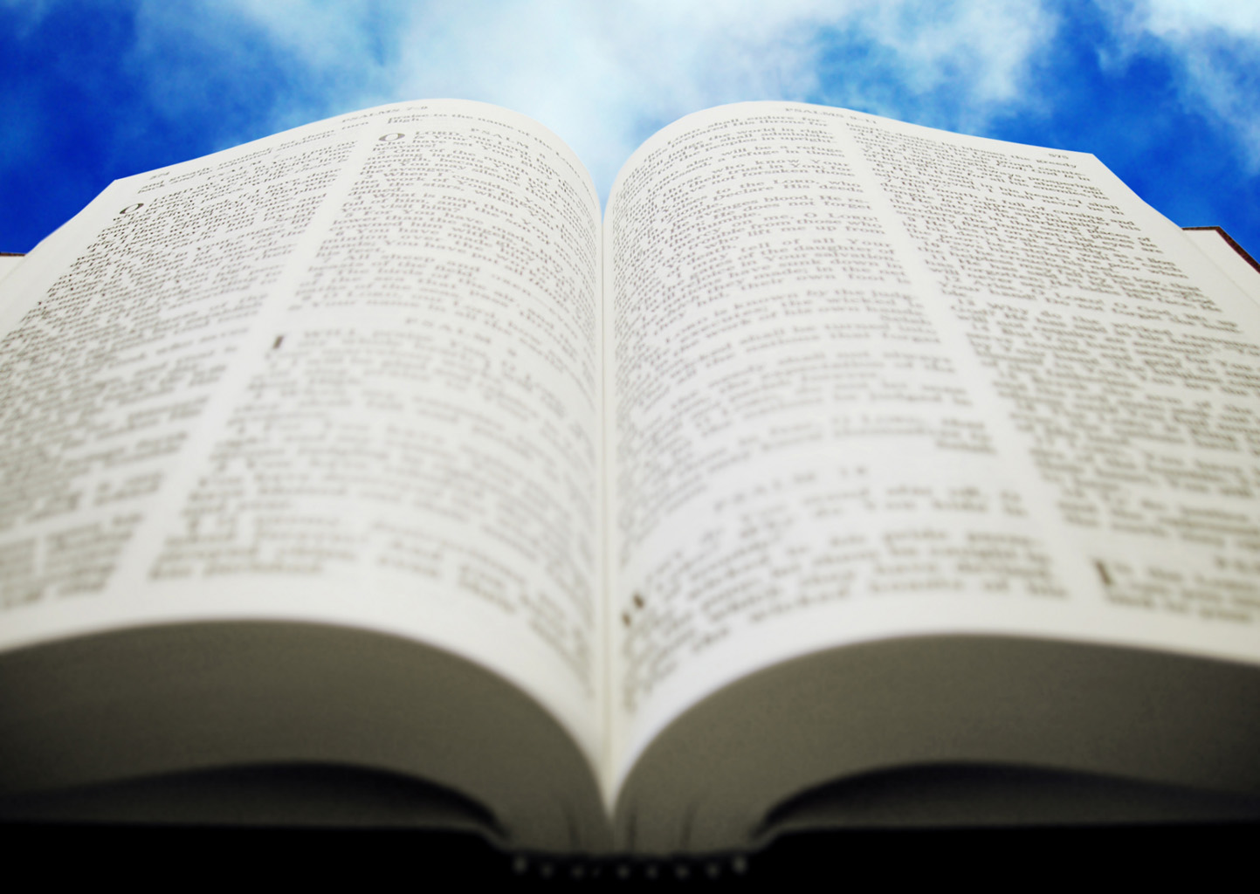
Welcome!
Sunday
Bible Study 9:30 AM
Worship 10:30 AM
PM Bible Class (Livestream) 5:00 PM
Wednesday
Bible Class 7:00 PM
www.SunsetchurchofChrist.net

Slide 2
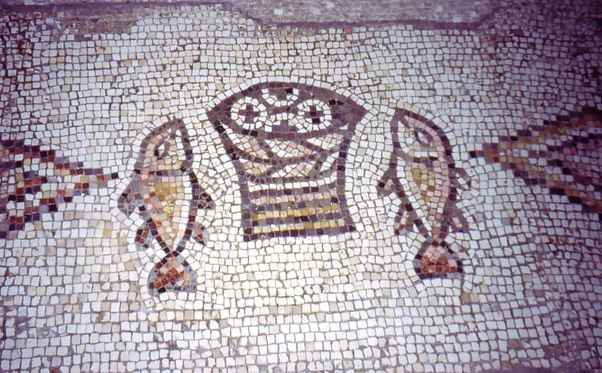
John 6:1-14
Loaves and Fishes
“Truly this is the Prophet”
Notes:
https://commons.wikimedia.org/wiki/File:Tabgha_Church_Mosaic_Israel.jpg

Slide 3
John 6:1-14
Loaves and Fishes
Nearing the Passover
“Truly this is the Prophet”

Slide 4
John 6:15-21
Jesus walking on the water
Matthew 14:33:
Peter joins Jesus walking
“Truly you are the Son of God”

Slide 5
Welcome!
Sunday
Bible Study 9:30 AM
Worship 10:30 AM
PM Bible Class (Livestream) 5:00 PM
Wednesday
Bible Class 7:00 PM
www.SunsetchurchofChrist.net

Slide 6
Opening Prayer | Rob Wade
Song – 155 | George Watkins
Scripture Reading | Lamar McDonald
Song – 451 | George Watkins
Song – 696 | George Watkins
Lord’s Supper | Lamar McDonald, Luis Gonzalez
Song – 504 | George Watkins
Collection | Lamar McDonald, Brian Haines
Song – 536 | George Watkins
Lesson | Brian Haines
Song – 272 | George Watkins
Closing | Antony Ward

Slide 7
John 14: The One With Us

Slide 8
John 14: The One With Us
God
Notes:
Ga 6:9 And let us not grow weary while doing good, for in due season we shall reap if we do not lose heart.

Slide 9
John 14: The One With Us
God
Mankind
Notes:
Ga 6:9 And let us not grow weary while doing good, for in due season we shall reap if we do not lose heart.

Slide 10
John 14: The One With Us
God
SIN
Mankind
Notes:
Ga 6:9 And let us not grow weary while doing good, for in due season we shall reap if we do not lose heart.

Slide 11
John 14: The One With Us
God
Jesus
Mankind
Notes:
Ga 6:9 And let us not grow weary while doing good, for in due season we shall reap if we do not lose heart.

Slide 12
John 14: The One With Us
Father
Jesus
Mankind
Notes:
Ga 6:9 And let us not grow weary while doing good, for in due season we shall reap if we do not lose heart.

Slide 13
John 14: The One With Us
Father
Jesus
Mankind
Spirit
Notes:
Ga 6:9 And let us not grow weary while doing good, for in due season we shall reap if we do not lose heart.

Slide 14
John 14: The One With Us
Father
Jesus
Mankind
Spirit
Notes:
Ga 6:9 And let us not grow weary while doing good, for in due season we shall reap if we do not lose heart.

Slide 15
John 14: The One With Us
Who is the Holy Spirit
He is a Person
He can be insulted, lied to, and grieved
Notes:
Ga 6:9 And let us not grow weary while doing good, for in due season we shall reap if we do not lose heart.

Slide 16
John 14: The One With Us
Who is the Holy Spirit
He is a Person
He is God
Acts 5:3-4
John 4:24
Notes:
Ac 5:3 But Peter said, "Ananias, why has Satan filled your heart to lie to the Holy Spirit and keep back part of the price of the land for yourself? 4 "While it remained, was it not your own? And after it was sold, was it not in your own control? Why have you conceived this thing in your heart? You have not lied to men but to God.“
Joh 4:24 "God is Spirit, and those who worship Him must worship in spirit and truth."

Slide 17
John 14: The One With Us
Who is the Holy Spirit
He is a Person
He is God
He has revealed Himself in the past:
As cloud, fire and wind
Notes:
Ga 6:9 And let us not grow weary while doing good, for in due season we shall reap if we do not lose heart.

Slide 18
John 14: The One With Us
Who is the Holy Spirit
He is a Person
He is God
He has revealed Himself in the past:
He is Paraklete
Notes:
Ga 6:9 And let us not grow weary while doing good, for in due season we shall reap if we do not lose heart.

Slide 19
John 14: The One With Us
Paraklete
Helper
Comforter
Counselor
Advocate
Notes:
Ga 6:9 And let us not grow weary while doing good, for in due season we shall reap if we do not lose heart.

Slide 20
John 14: The One With Us
Where is He?
Manifested in the Word
John 6:63
Ephesians 5:19 w/Colossians 3:16
Notes:
Joh 6:63 "It is the Spirit who gives life; the flesh profits nothing. The words that I speak to you are spirit, and they are life.

Slide 21
John 14: The One With Us
How does He help?
Romans 8:26 – Prayer
1 Corinthians 2:11-12 – Understanding
For salvation
For living
Notes:
Ro 8:26 ¶ Likewise the Spirit also helps in our weaknesses. For we do not know what we should pray for as we ought, but the Spirit Himself makes intercession for us with groanings which cannot be uttered.
1Co 2:11 For what man knows the things of a man except the spirit of the man which is in him? Even so no one knows the things of God except the Spirit of God. 12 Now we have received, not the spirit of the world, but the Spirit who is from God, that we might know the things that have been freely given to us by God.

Slide 22
John 14: The One With Us
God did not leave us alone
“I am with you always”
He is teaching us and saving us daily
“They shall all be taught by God”
“The Spirit is life”
Notes:
Mt 28:20 "teaching them to observe all things that I have commanded you; and lo, I am with you always, even to the end of the age." Amen.
Joh 6:45 "It is written in the prophets, 'And they shall all be taught by God.' Therefore everyone who has heard and learned from the Father comes to Me.
Ro 8:10 ¶ And if Christ is in you, the body is dead because of sin, but the Spirit is life because of righteousness.

Slide 23
Notes:
Lu 18:10 "Two men went up to the temple to pray, one a Pharisee and the other a tax collector. 11 "The Pharisee stood and prayed thus with himself, 'God, I thank You that I am not like other men--extortioners, unjust, adulterers, or even as this tax collector. 12 'I fast twice a week; I give tithes of all that I possess.‘ 13 "And the tax collector, standing afar off, would not so much as raise his eyes to heaven, but beat his breast, saying, 'God, be merciful to me a sinner!‘ 14 "I tell you, this man went down to his house justified rather than the other; for everyone who exalts himself will be humbled, and he who humbles himself will be exalted.“
Mr 11:25 "And whenever you stand praying, if you have anything against anyone, forgive him, that your Father in heaven may also forgive you your trespasses.

Slide 24
I am the Way
No one comes to the Father but thru Him
Notes:
Lu 18:10 "Two men went up to the temple to pray, one a Pharisee and the other a tax collector. 11 "The Pharisee stood and prayed thus with himself, 'God, I thank You that I am not like other men--extortioners, unjust, adulterers, or even as this tax collector. 12 'I fast twice a week; I give tithes of all that I possess.‘ 13 "And the tax collector, standing afar off, would not so much as raise his eyes to heaven, but beat his breast, saying, 'God, be merciful to me a sinner!‘ 14 "I tell you, this man went down to his house justified rather than the other; for everyone who exalts himself will be humbled, and he who humbles himself will be exalted.“
Mr 11:25 "And whenever you stand praying, if you have anything against anyone, forgive him, that your Father in heaven may also forgive you your trespasses.

Slide 25
Are You Heard by God?
Therefore lay aside all filthiness and overflow of wickedness, and receive with meekness the implanted word, which is able to save your souls. James 1:21
Notes:
Lu 18:10 "Two men went up to the temple to pray, one a Pharisee and the other a tax collector. 11 "The Pharisee stood and prayed thus with himself, 'God, I thank You that I am not like other men--extortioners, unjust, adulterers, or even as this tax collector. 12 'I fast twice a week; I give tithes of all that I possess.‘ 13 "And the tax collector, standing afar off, would not so much as raise his eyes to heaven, but beat his breast, saying, 'God, be merciful to me a sinner!‘ 14 "I tell you, this man went down to his house justified rather than the other; for everyone who exalts himself will be humbled, and he who humbles himself will be exalted.“
Mr 11:25 "And whenever you stand praying, if you have anything against anyone, forgive him, that your Father in heaven may also forgive you your trespasses.

Slide 26
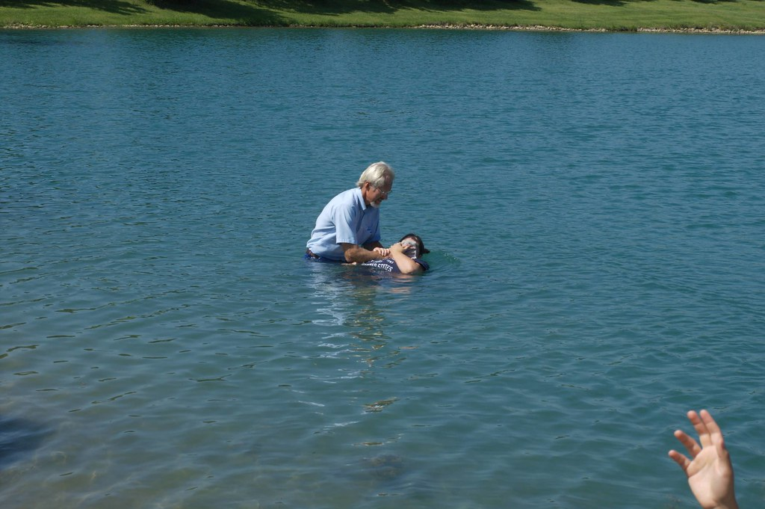
Are You Heard by God?
There is also an antitype which now saves us--baptism (not the removal of the filth of the flesh, but the answer of a good conscience toward God), through the resurrection of Jesus Christ 1 Peter 3:21
Notes:
Lu 18:10 "Two men went up to the temple to pray, one a Pharisee and the other a tax collector. 11 "The Pharisee stood and prayed thus with himself, 'God, I thank You that I am not like other men--extortioners, unjust, adulterers, or even as this tax collector. 12 'I fast twice a week; I give tithes of all that I possess.‘ 13 "And the tax collector, standing afar off, would not so much as raise his eyes to heaven, but beat his breast, saying, 'God, be merciful to me a sinner!‘ 14 "I tell you, this man went down to his house justified rather than the other; for everyone who exalts himself will be humbled, and he who humbles himself will be exalted.“
Mr 11:25 "And whenever you stand praying, if you have anything against anyone, forgive him, that your Father in heaven may also forgive you your trespasses.

